Slide 1
Memory management for virtual memory system
Cam Tu Hoang, Tyson Skogerboe, Su-Wei Yang

Slide 2
Outline
Introduction
Implementation
Result

Slide 3
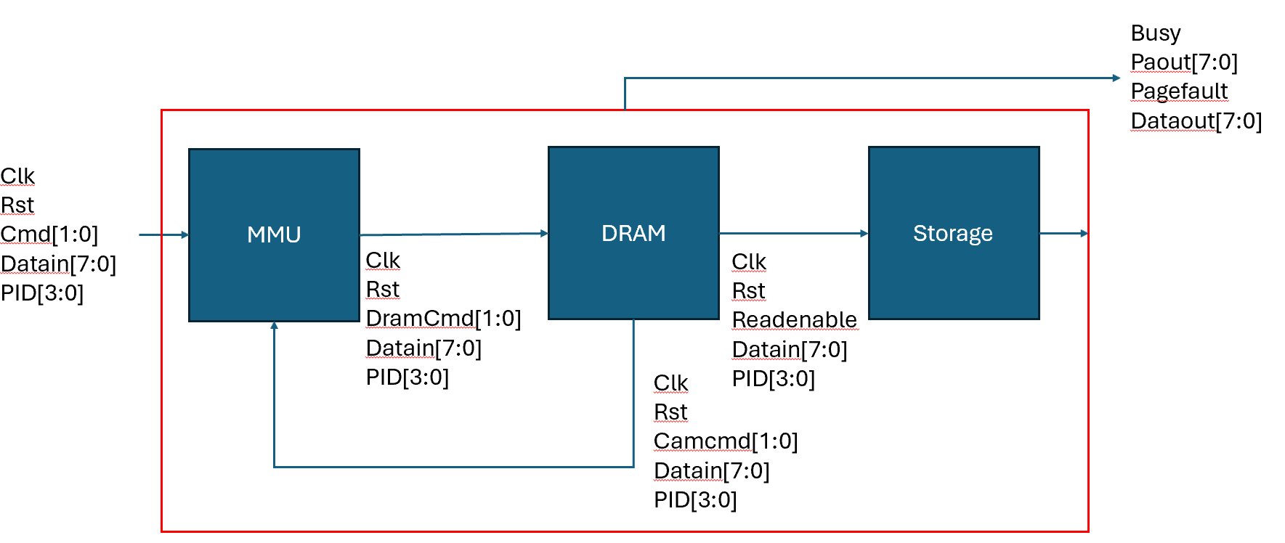
Introduction
Input: 8 bits virtual address
Output: 8 bits physical address and data
MMU: stores page tables
DRAM: stores page tables
Storage: stores data

Slide 4
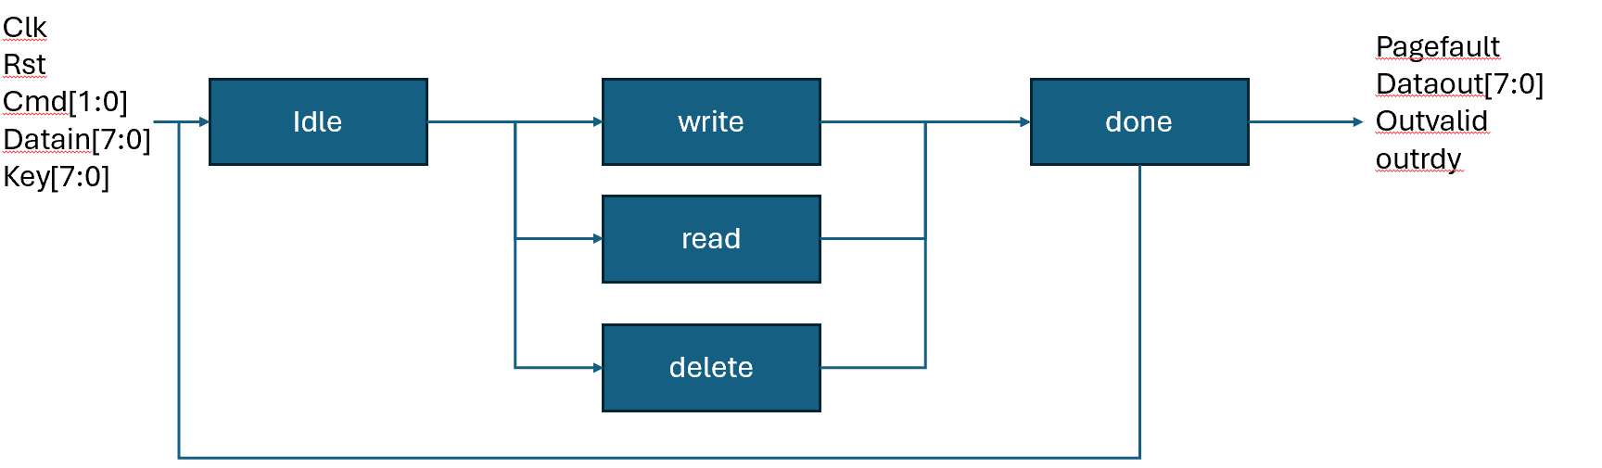
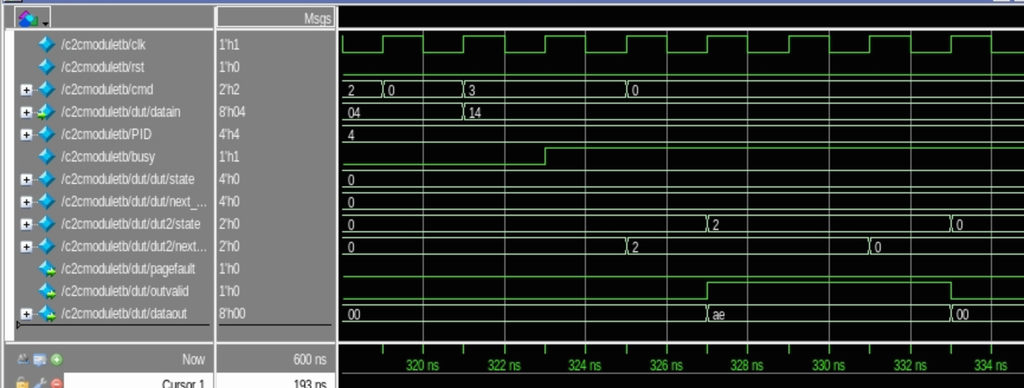
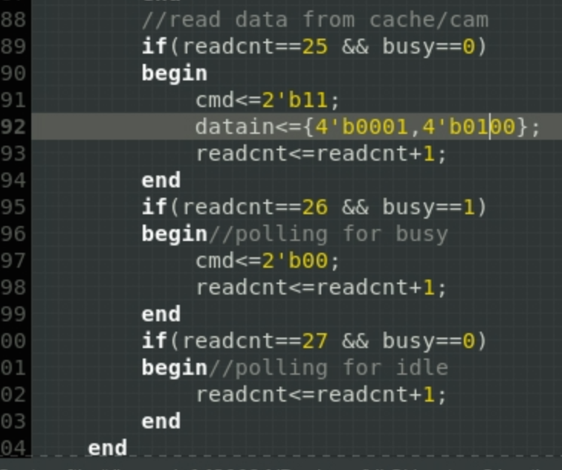
Implementation- cam & cache
Cam translation

Slide 5
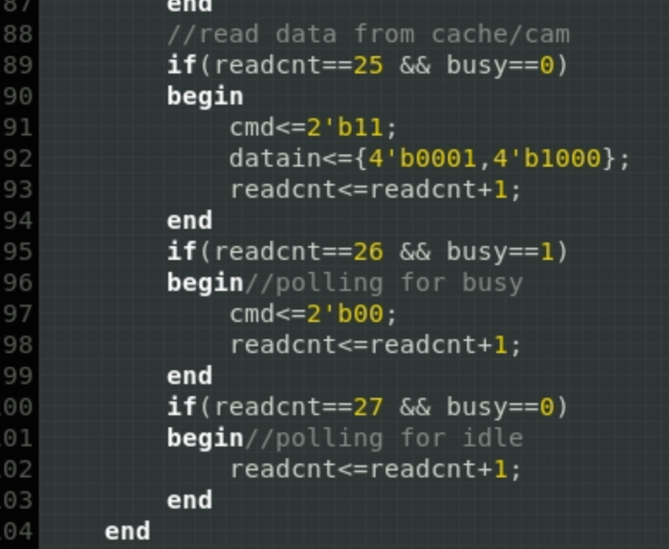
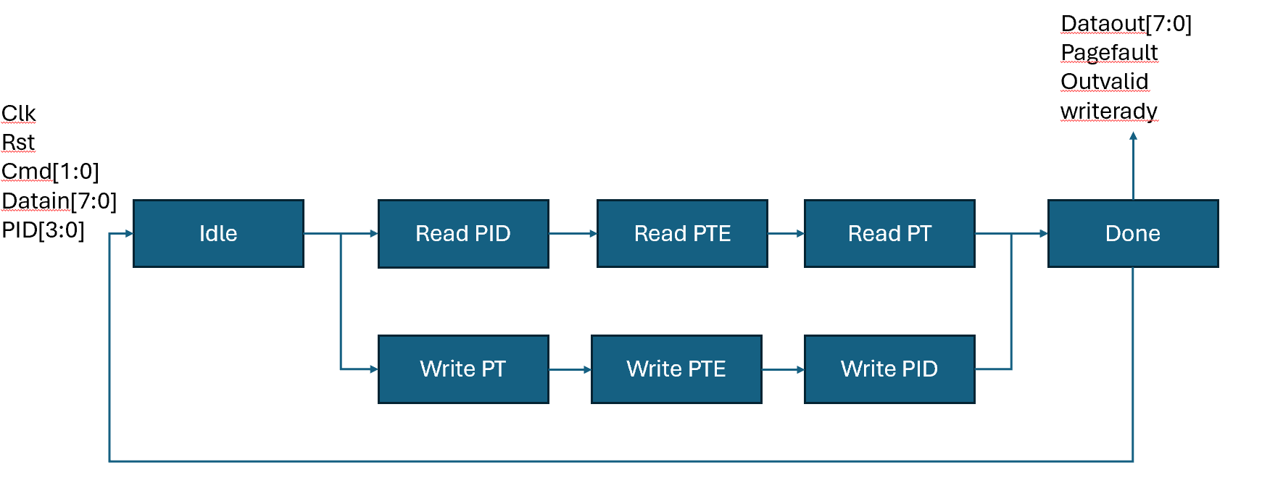
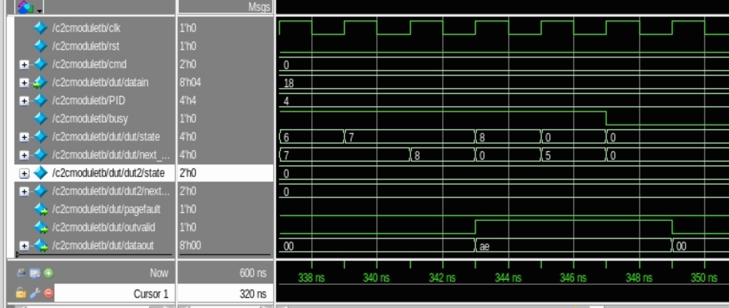
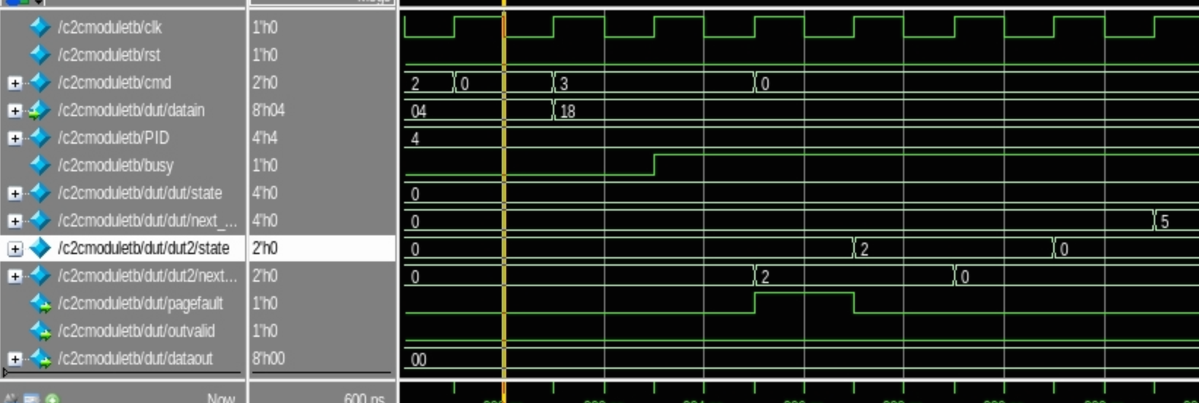
Implementation- cam & cache
cache translation

Slide 6
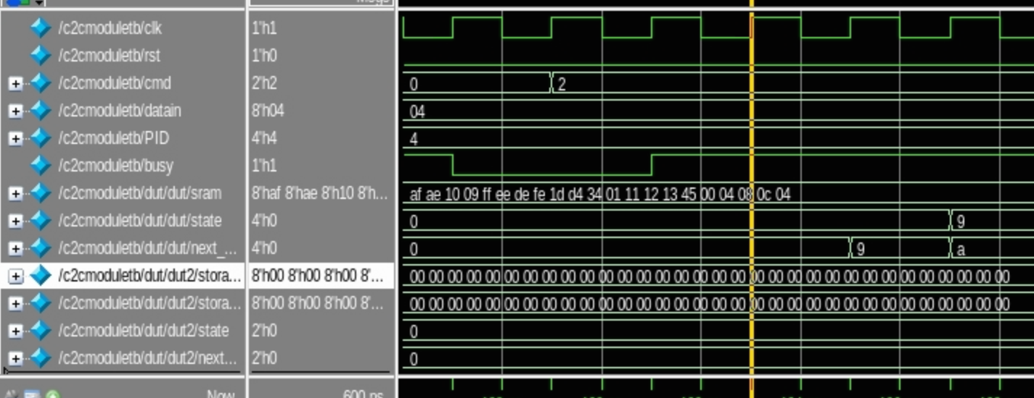
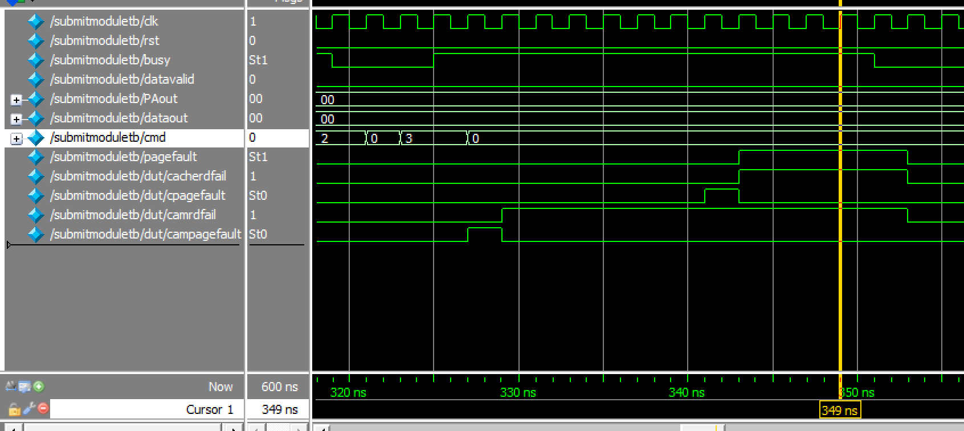
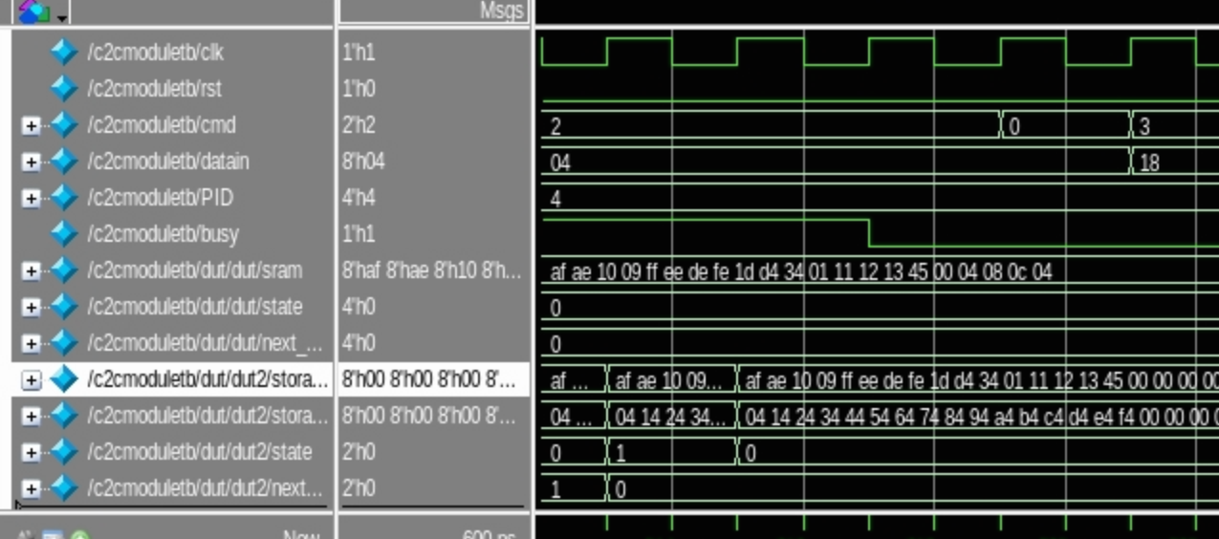
Implementation- cam & cache
<- Cam & cache interaction
Cam & cache page fault ->

Slide 7
Implementation -dram
Mange read and write operation for virtual memory page table
Handle page fault, address translation and data loading
No Page fault
Cam
Cache
Dram
Storage
Page fault

Slide 8
Implementation - dram
Detect page fault during address translation
Sequentially update page table during write operation
Sequentially output physical address during load operation
Idle
Read PID
Read PTE
Read PT
Done
Clk
Reset
Datain[7:0]
PID[3:0]
Cmd[1:0]
Write
Load

Slide 9
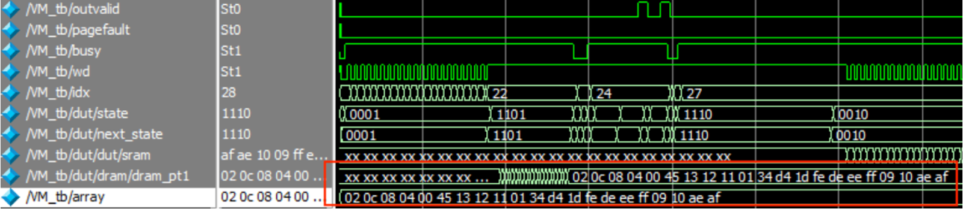
Implementation - dram
DRAM is initially empty, then it is filled with data from the input array
On load command, page tables will be loaded from dram to cache

Slide 10
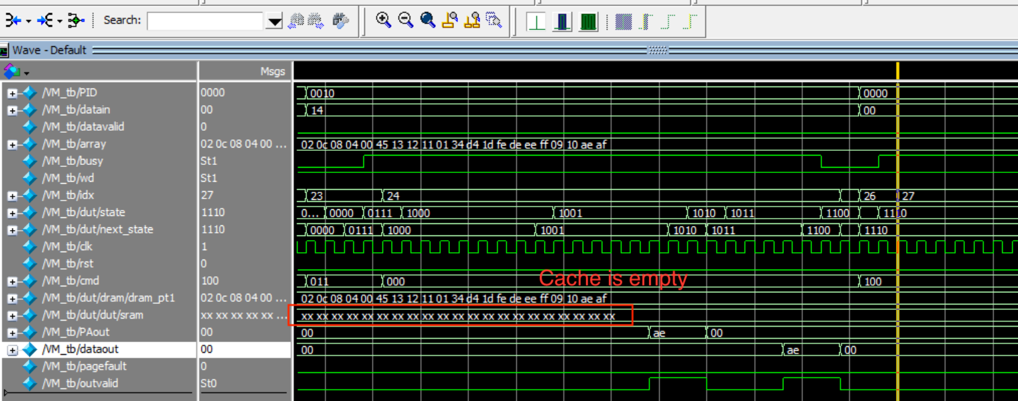
Implementation - dram
Cam, cache, dram interaction

Slide 11
Implementation - Storage
Address [7:0]
Read
Process ID [2:0]
Memory Array
Out_Ready
Address [7:0]
Reset
Write
Process ID [2:0]
Idle
Clock
Write
Data In [7:0]
Write_Valid
Address [7:0]
Erase
Process ID [2:0]
Erase
Erase_Done
Busy_Flash

Slide 12
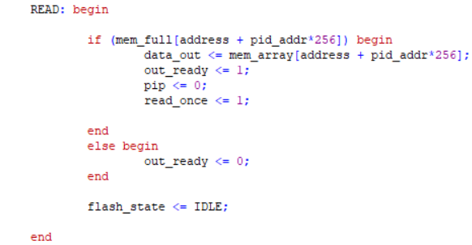
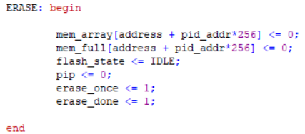
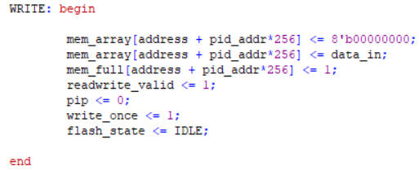
Implementation - Storage

Slide 13
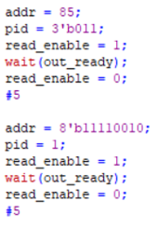
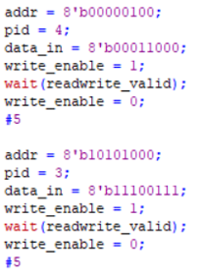
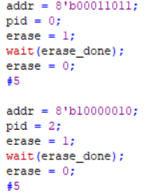
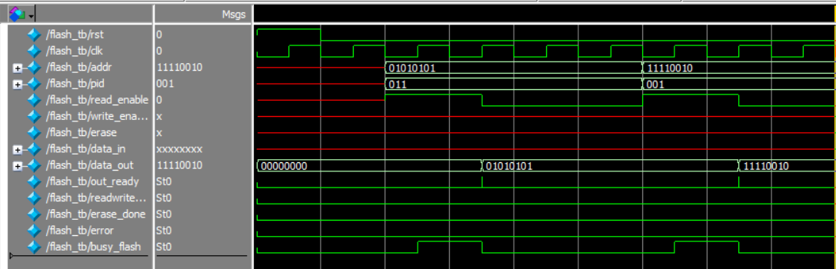
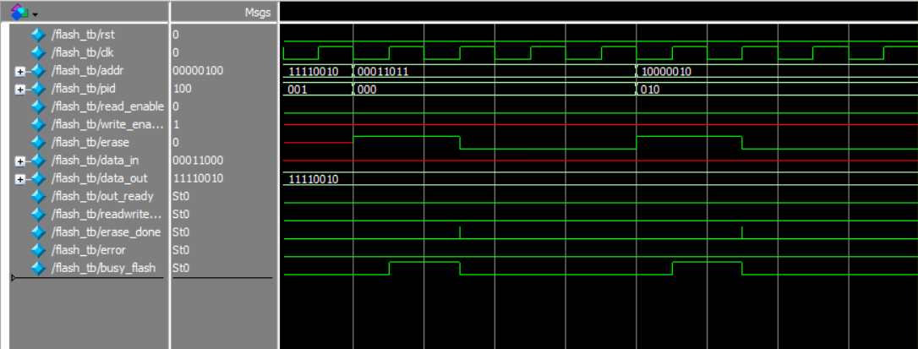
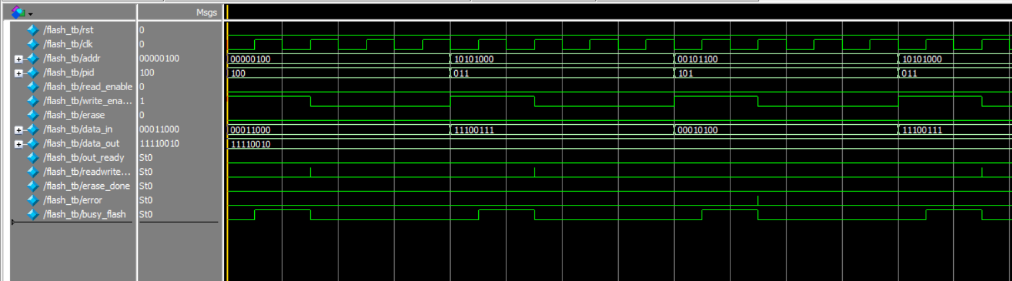
Implementation - Storage

Slide 14
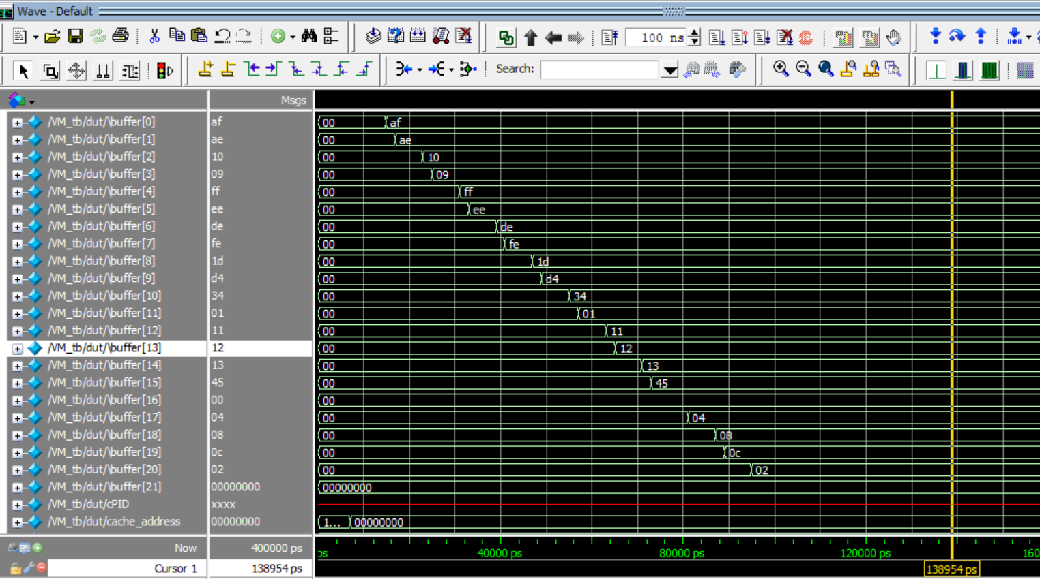
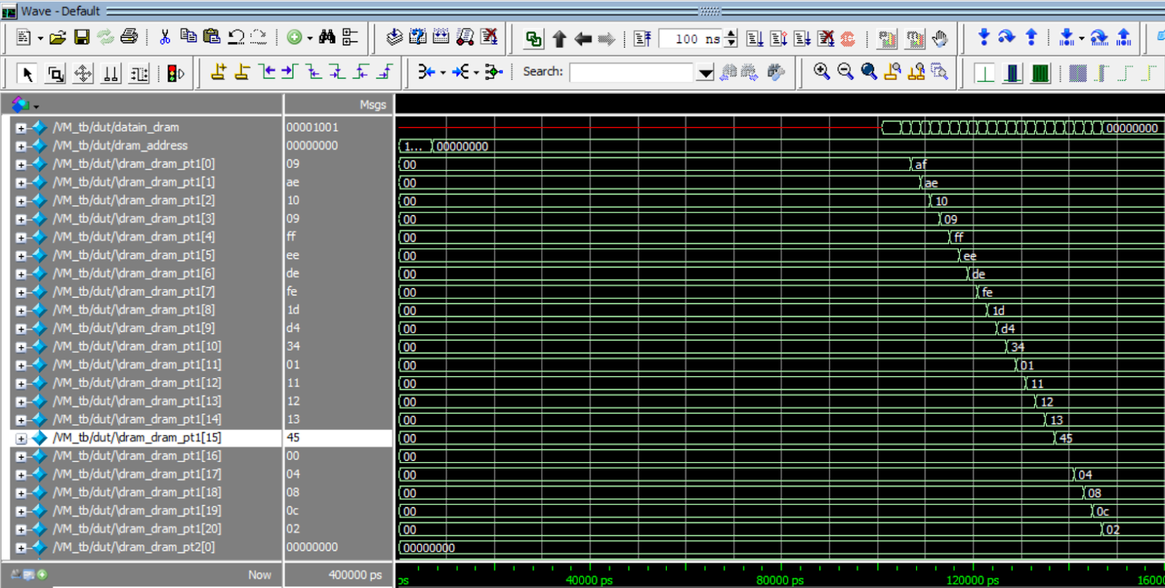
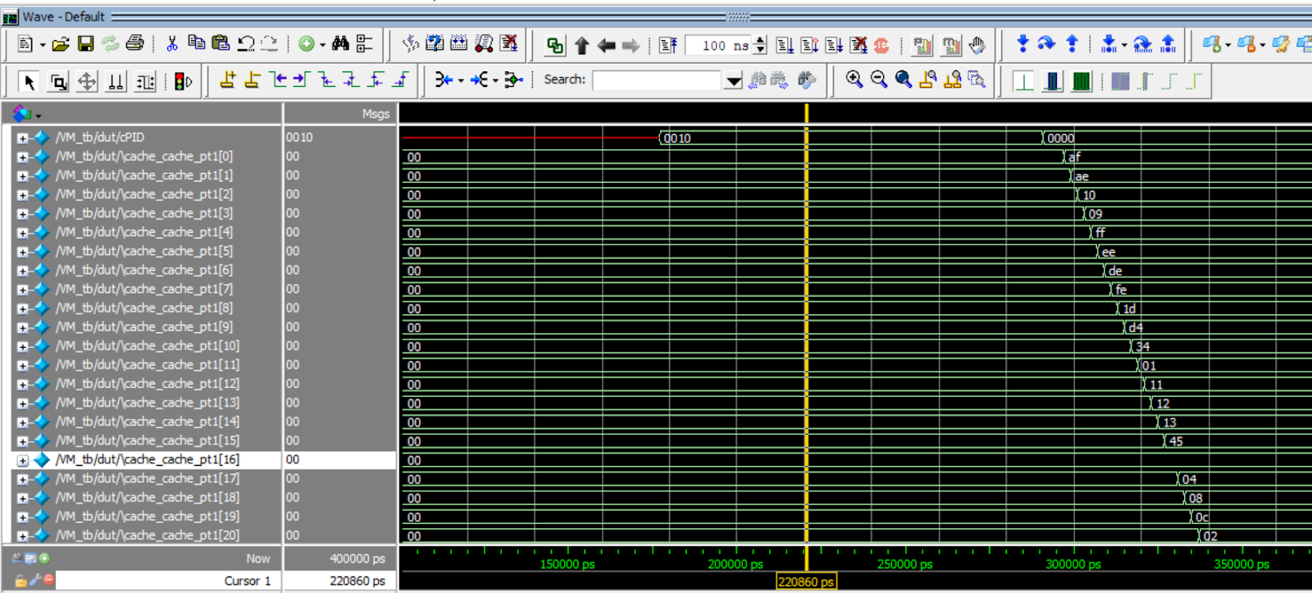
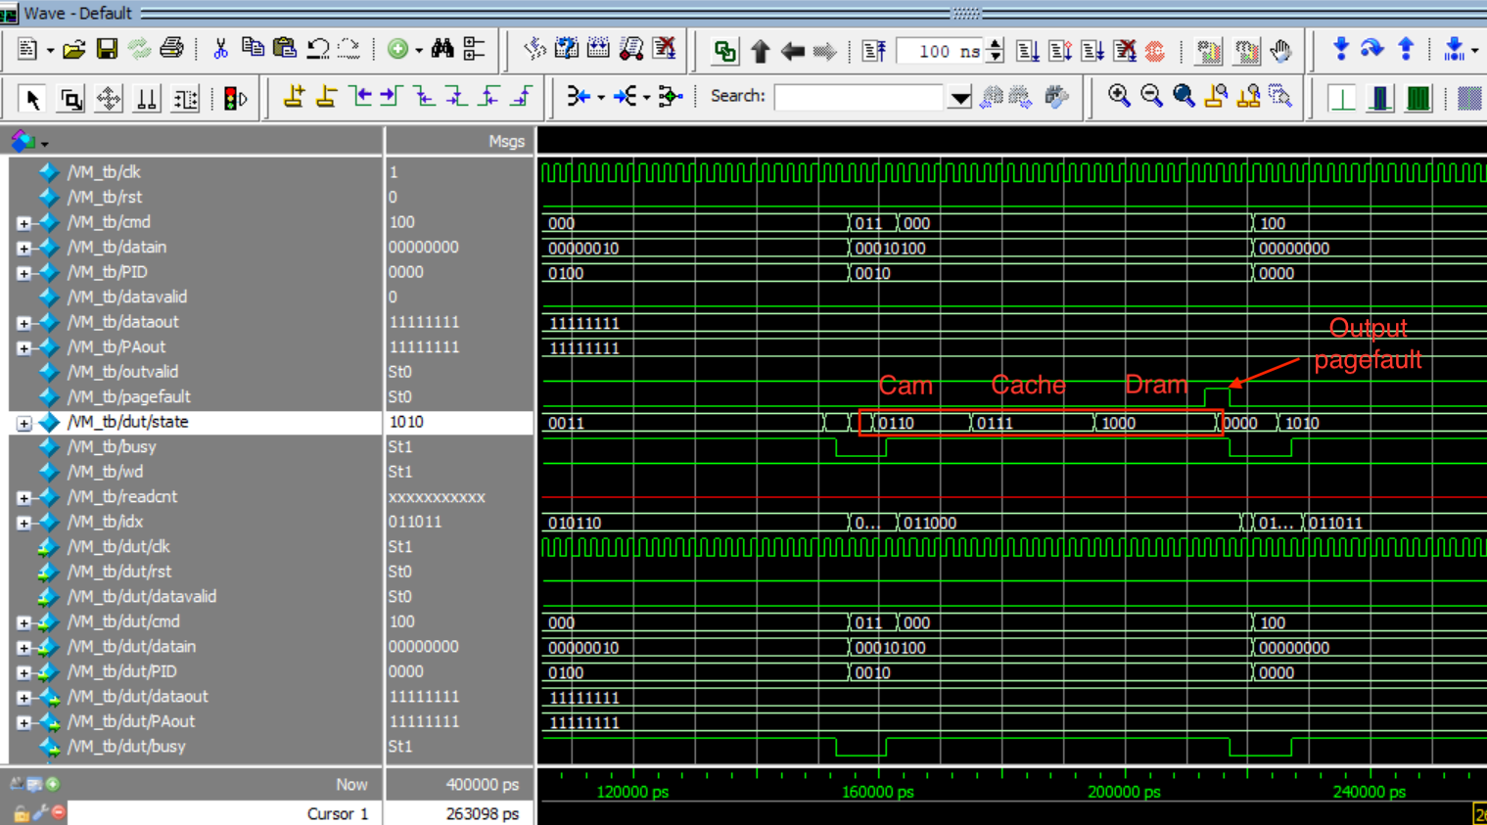
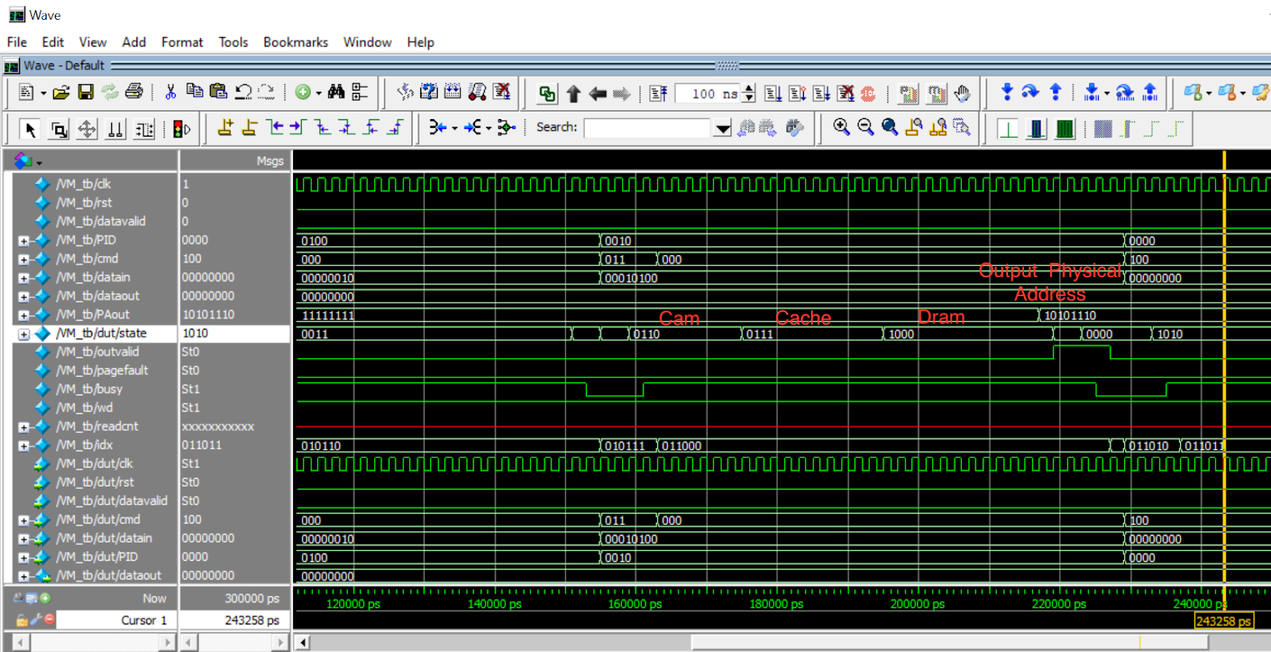
Post-synthesis validation

Slide 15
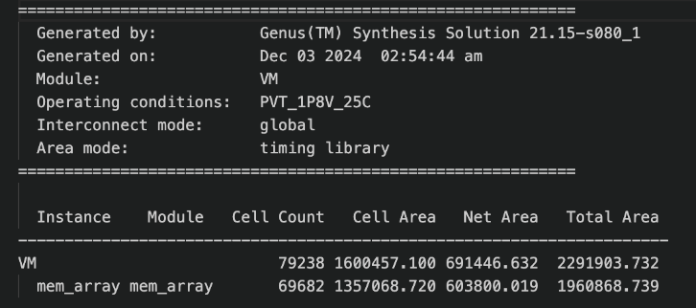
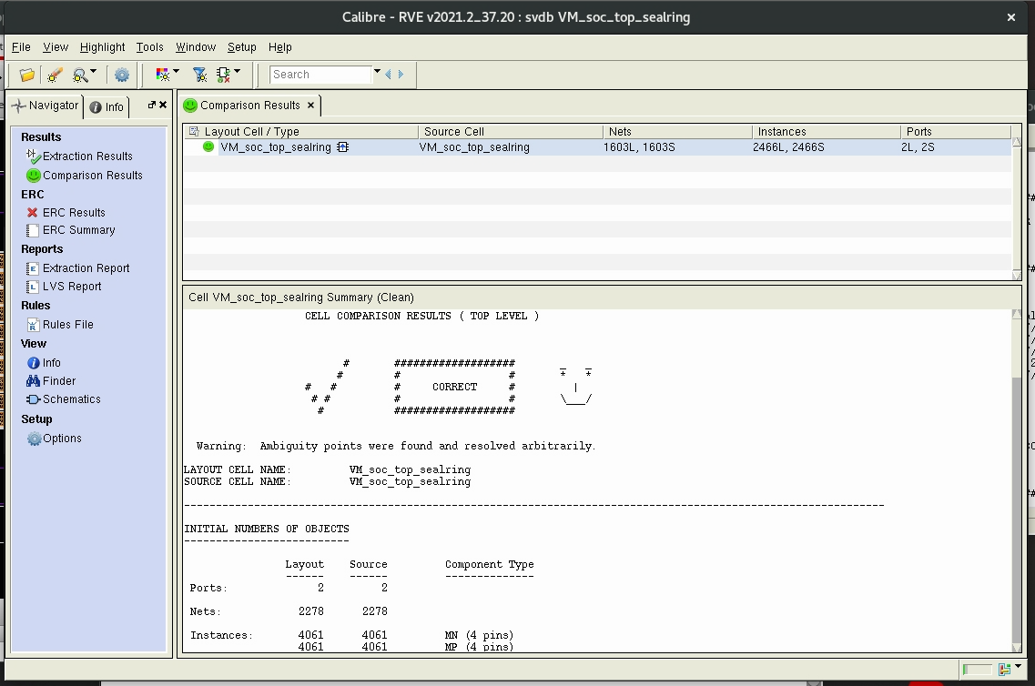
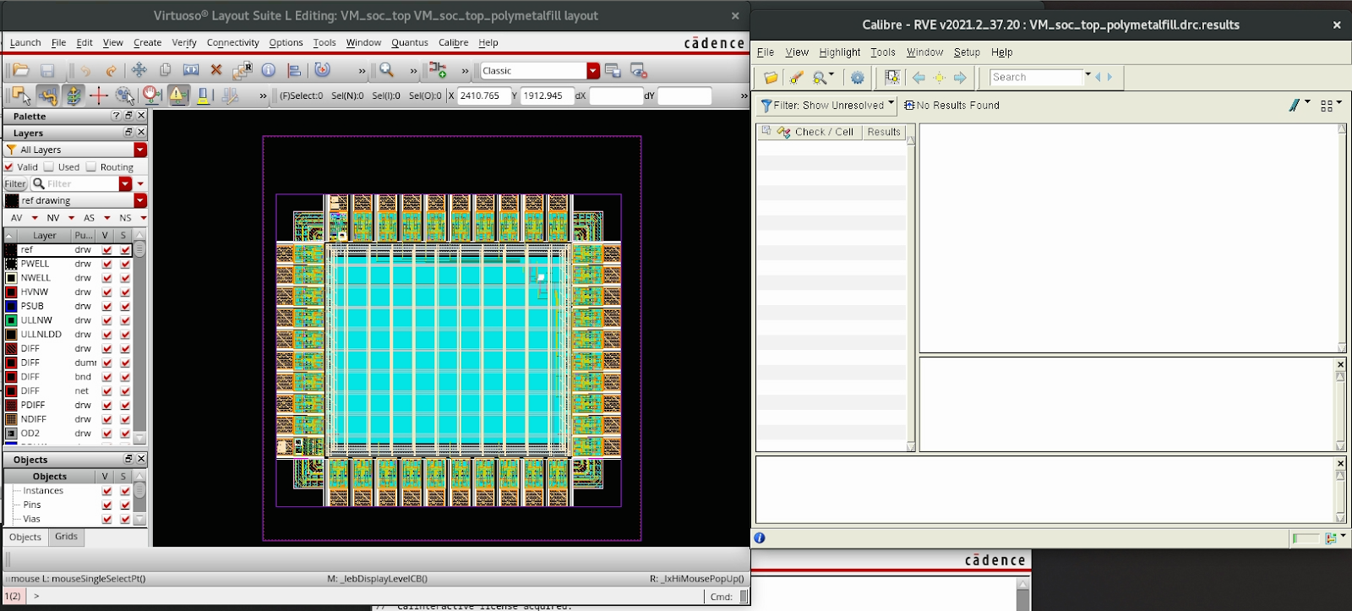
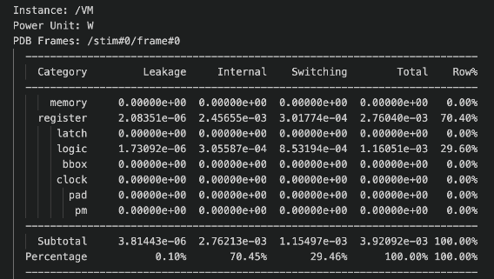
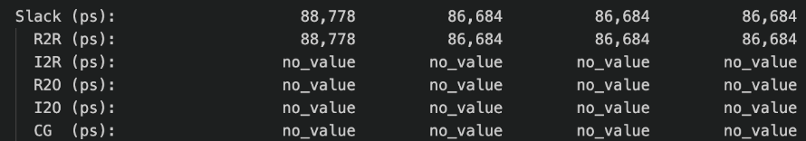
Result

